Slide 1
Having Fun With Integer Operations
Jesse Spehar and Trevor Delahoy
SUNY Fredonia
AMTNYS, October 28, 2011

Slide 2
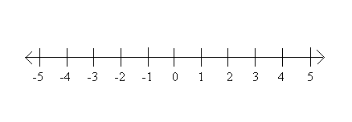
Teaching Integer Operations
Teaching integer operations can be very troublesome when negative numbers get involved.
Usually, most students are taught the number horizontally, what if we were to teach this concept vertically instead?

Slide 3
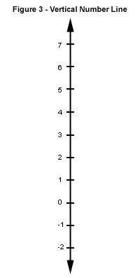
The Vertical Number Line
To many students looking at a vertical number line may be easier to understand than the horizontal number line.
But what is a strategy we could use that students would understand?

Slide 4
The Hot Air Balloon
When you think of a hot air balloon, you think of a big balloon full of helium that can either go up or down depending on how much helium you have in the balloon and the amount of weight you have in the basket.
So, why not try using this concept to teach your students integer operations?
But how would you do it?

Slide 5
The Hot air balloon contd.
First start with your vertical number line, with zero being in the middle.
Place your hot air balloon on the number line at zero
KEY:
“Put on” = “addition”
“Take off” = “subtraction”
1 weight = -1
1 balloon = +1

Slide 6
How the process works
Remember that the balloon always starts at zero on the number line.
Depending on the signs of the numbers will determine whether to use balloons or weights.
Depending on the main operation of the problem will determine whether you are going to be “putting on” or “taking off” either weights or balloons.

Slide 7
Seeing the Process in Action
Now let’s try to use this process to solve the problems below
5+5
Add 5 balloons, then add 5 more balloons
3−3
Add 3 balloons, then take away three balloons
7+(−3)
Add 7 balloons, then add three weights
3−5
Add 3 balloons, then take 5 balloons away
5−(−6)
Add 5 balloons, then take away 6 weights
−10−(−2)
Add 10 weights, then take away 2 weights
−8+(−3)
Add 8 weights, then add three more weights
KEY: Remember the first integer you will always “add on” and the second will depend on the operation
“Put on” = “addition”
“Take off” = “subtraction”
1 weight = -1
1 balloon = +1

Slide 8
Another visual way to solve integer operations
“Walk the Line”
This is a process which uses a horizontal number line and walking in a certain direction depending on the sign of the integers and the sign of the operation you are solving for to get to your answer using the manipulative.

