Slide 1
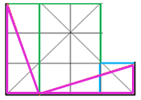
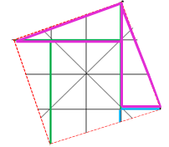
The Stolen Theorem
Cut Out Proof!
Fun, hands-on activity that provides a concrete way to prove
Pythagorean Theorem
Pythagoras of Samos was a Greek Mathematician living around 500 B.C.
Pythagoras is recorded to have been the first to prove the theorem is true for all right triangles!
HOWEVER! There is evidence that the Babylonians and Egyptians had been using the formula 500 years before Pythagoras! Therefore Pythagoras “STOLE” all the credit! ☺
The Folding Proof!
How do we use the paper to show that the Pythagorean Theorem is true? We want to physically see that: $a^{2}+b^{2}=c^{2}$
$${∴c}^{2}=a^{2}+b^{2}$$
It is the Pythagorean Theorem!
Fold the paper so that we only see the area: $a^{2}+b^{2}$. (In order to do this you must make a cut along$a$ for the length of$a$).
Sherri Maine
SMaine @fredonia.edu
We know that the red dotted line represented the hypotenuse, $c$. The red dotted line borders the square found above. Therefore we have found the area of $c^{2}$!
$a^{2}+b^{2}=c^{2}$ must be true!
Stephen Kirsch
SKirsch @fredonia.edu

