Slide 1
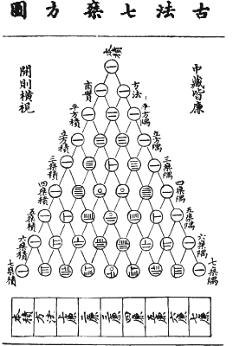
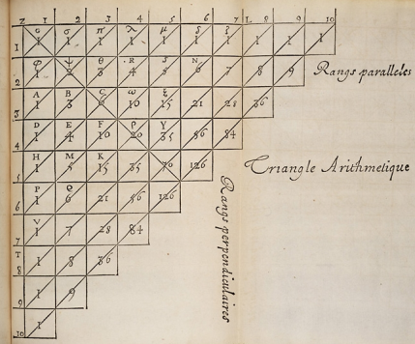
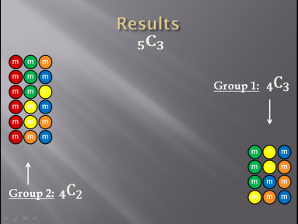
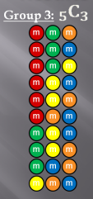
Pascal’s Triangle:
In Living Color
By: Kyle Parsons and Peter Marshfield
$$1$$
$$1 1$$
$$1 2 1$$
$1$ 3 3 1
$1$ 4 6 4 1
Pingala – 10th Century
Pascal– 17th Century
$$1 5 10 10 5 1$$
$$⋮$$
₀C₀
₁C₀ ₁C₁
₂C₀ ₂C₁ ₂C₂
₃C₀ ₃C₁ ₃C₂ ₃C₃
₄C₀ ₄C₁ ₄C₂ ₄C₃ ₄C₄
₅C₀ ₅C₁ ₅C₂ ₅C₃ ₅C₄ ₅C₅

