Slide 1
The Circle of Life! Brain Busters for Your Classroom
Presented by:
Rebecca Jackson
Elyssa Adams

Slide 2
Concentric Circles
What if we inscribed a circle into a square.
Now, inscribe that square into a larger circle.

Slide 3
Which Area Is Bigger?
The purple ring?
The yellow circle?
Are they equal?
Not enough information to answer?

Slide 4
Concentric Circles
Let’s bring back the square.
We can find the radius of the yellow circle.
Using Right Triangle Trig, we can then find the radius of the purple circle.
Since we know both the radii of the yellow and purple circles, we can find the area of each.
$A_{p}=π{\left(r\sqrt{2}\right)}^{2}=2πr^{2}$
$A_{y}=πr^{2}$
$$r\sqrt{2}$$
r

Slide 5
The Results…
Do you want to change your answer now? Does anyone know what the answer is?
By subtracting the yellow area from the purple area, we come to find that…
Their areas are EQUAL!
$$r\sqrt{2}$$
r

Slide 6
The Benefits Of This Problem:
Real-Life Applications:
Tires and Wheels
Donut vs. Tim-bit
Architecture
Topics Covered:
Properties of Circles
Area
Diameter
Radius
Right Triangle Trig

Slide 7
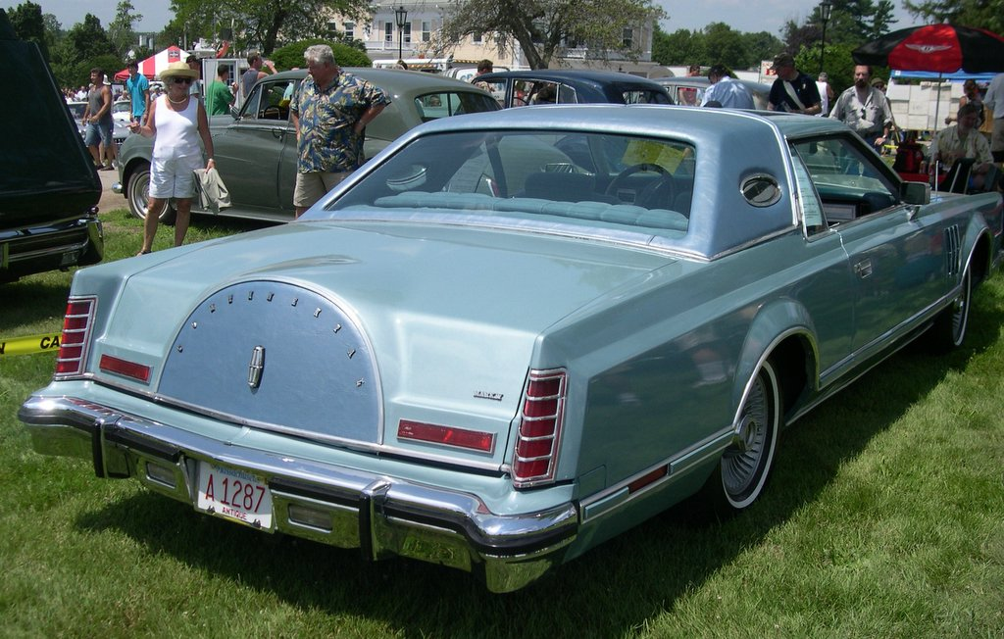
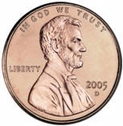
Taking a Lincoln for a spin!
If a penny has a diameter of .75 inches and the circle has a diameter of 1.5 inches, how far will the penny have traveled after one revolution?

Slide 8
Let’s Try It!
Everyone please take a penny and a circle.
Try rotating the penny around the circle once (without it sliding), keeping track of how many revolutions you get.
Did the person next to you get the same number?

Slide 9
The Mathematics Behind It
Similarity of Circles
We can set up a proportion of circumferences and radii
$\frac{c}{C}=\frac{r}{R}$
Does anyone have an answer yet?
1 revolution = $\frac{.375}{.75}$ =.5
After one revolution, the penny will have traveled half the circumference of the circle.
Is it always .5?
No! Why? This is just because the penny had half the radius of the larger circle.

Slide 10
Crafty Crescents
Given this figure, which as more area?
The pink?
The yellow?
Or are they the same?

Slide 11
Crafty Crescents
If we let $x$ be the base and height of the triangle.
$A_{∆}=\frac{x^{2}}{2} {units}^{2}$
We can also find the area of the larger blue circle.
$A_{∘}=π\left(\frac{x^{2}}{2}\right){units}^{2}$
${\frac{1}{2}A}_{∘}=π\left(\frac{x^{2}}{4}\right){units}^{2}$
${\frac{1}{2}A}_{∘}−A_{∆}$ will give us the area of the blue areas adjacent to the triangle.
So now what?

Slide 12
Crafty Crescents
Now we need to subtract the area of the blue regions from the pink semicircles.
Finding the area of the pink semicircle:
$A_{∘∘}=\left(\frac{π}{8}x^{2}+\frac{π}{8}x^{2}\right)$
Subtracting the areas to get the pink crescents.
$A_{⌒}=\left(\frac{π}{8}x^{2}+\frac{π}{8}x^{2}\right)−\left(\frac{π}{4}x^{2}−\frac{x^{2}}{2}\right)$
Does anyone notice anything? Do you have an answer?
The answer is…
The areas are the same!

Slide 13
The Benefits Of This Problem:
Topics Covered:
Properties of Circles
Area
Radius
Diameter
Inscribed Angles
Triangle Area
Semi-circles
Right Triangle Trig
Problem Solving Skills
Real-Life Applications:
Painting
Architecture
Sewing

Slide 14
Why These Are Good Problems
Twist on classic geometry problems
Help students utilize basic topics and apply them in different, creative ways
Allow students to think “outside of the circle”

