Slide 1
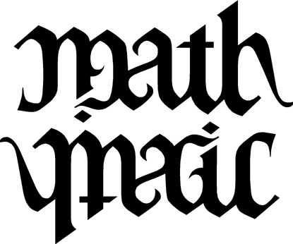
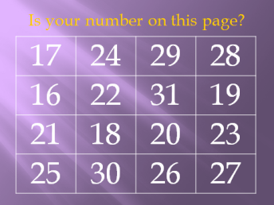
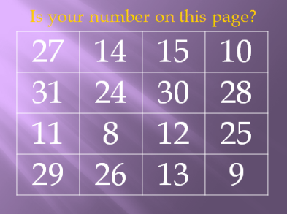
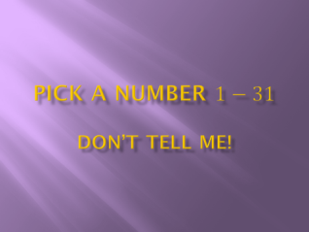
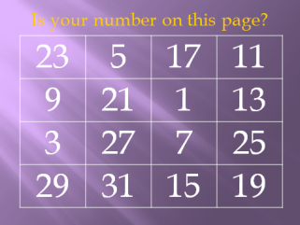
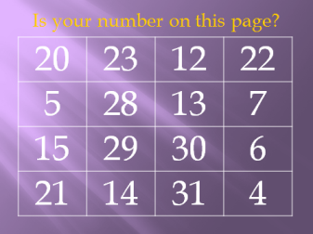
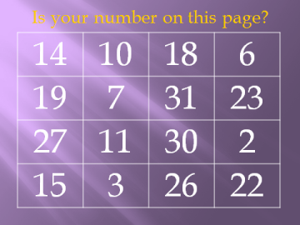
Mathematician or Magician?!
Mabra Karpie & Jamie Ross
mkarpie@fredonia.edu jross@fredonia.edu
Functional Card Trick
K.A.1 Use a variety of manipulatives to create patterns using attributes of color, size, or shape
4.A.5 Analyze a pattern or a whole-number function and state the rule, given a table or an input/output box
8.R.11 Use mathematics to show and understand mathematical phenomena (e.g., use tables, graphs, and equations to show a pattern underlying a function)
A2.A.37 Define a relation and function
Binary Representation
6.N.25 Evaluate expressions having exponents where the power is an exponent of one, two, or three
Start here:
The Functional Card Trick
Stacked Deck
“CHaSeD”
Composite Functions
Where in the curriculum?
Functions
Composition of functions
Modular arithmetic
Binary Representation
Every positive integer has a unique binary representation. In layman’s terms, every positive integer can be written as a sum of powers of 2.
You can add more cards to guess numbers up to one less than a power of two. For example, you can add one more card to guess numbers up to 63.
Where in the curriculum can you use this?
Introduction to binary numbers
Exponents & powers
Place Value
Students attempt to identify certain shapes used in Snowy Night.

