Slide 1
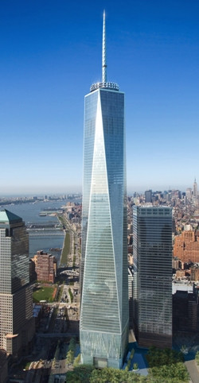
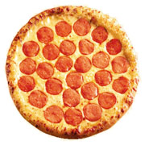
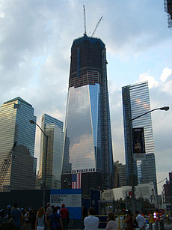
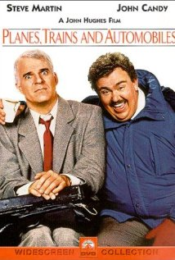
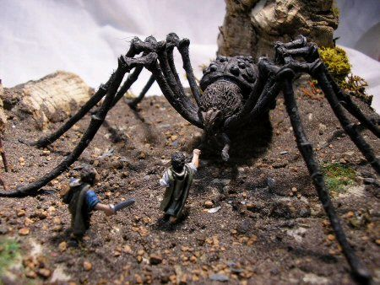
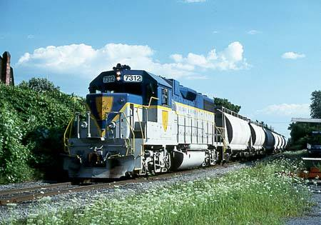
Pizzas, Trains and Proportional Reasoning
Andrew Carucci – caru9631@fredonia.edu
Kyle Erlandson – erla8236@fredonia.edu
Linear Proportions
Area Proportions
Freedom Tower is due to be completed by the end of 2012. Right now it stands at 1,026 feet, which is 75% of its final height. How tall will Freedom Tower be when completed?
A personal 6-inch pizza costs $3.79
A medium 12-inch pizza costs $10.99
Which is the better buy?
Two 6-inch pizzas for $7.58 or one
12-inch pizza for $10.99?
12 Inches
6 Inches
Volume Proportions
A $\frac{1}{87}$ scale model of the train below weighs 14 ounces. The actual train weighs 250,000 pounds. Which would proportionally weigh more?
Giant Spiders Can’t Exist!

