Slide 1
Stump The Chump
Jerica Morgan
SUNY Fredonia

Slide 2
Why is anything raised to the zero power equal to 1?
PROOF BY EXAMPLE/PATTERN
$$3^{1} 3^{2} 3^{3} { 3}^{4}$$
$$3 9 27 81$$
Pattern?!
$$… 3^{−3} 3^{−2} 3^{−1} 3^{0} 3^{1} 3^{2} 3^{3} 3^{4} ....$$
$$…\frac{1}{27} \frac{1 }{9} \frac{1}{3} 1 3 9 2 81 ....$$

Slide 3
More Rigorous Proof…
Proof using law of exponents
Provided $b≠0:$
$$\frac{b^{x}}{b^{y}}=b^{x−y} \text{or} b^{x}b^{y}=b^{x+y}$$
$$b^{0}\left(b^{1}\right)=b^{0+1}$$
$$b^{0}=\frac{b^{0+1}}{b^{1}}$$
$$b^{0}=\frac{b^{1}}{b^{1}}$$
$$b^{0}=1$$

Slide 4
Why does 0!=1?!
In general:
$$b! = 1∗2∗3∗...∗b$$
$$1!=1$$
$$2!=1!∗2$$
$$3!=2!∗3$$
$$4!=3!∗4$$
$$5!=4!∗5$$

Slide 5

Working backwards…
$$\frac{5!}{5}=4!$$
$$\frac{4!}{4}=3!$$
$$\frac{3!}{3}=2!$$
$$\frac{2!}{2}=1!$$
$$\frac{1!}{1}=0!$$
$$1=0!$$

Slide 6
Why can't you divide by 0?
Relate multiplication with division:
$$\frac{14}{7}=2$$
Why? …
$$7\left(2\right)=14$$
Now try 0:
$$\frac{14}{0}=x$$
What is $x$ ?!
$$x\left(0\right)≠14$$
But, zero times ANYTHING is zero, so there is NO SOLUTION!

Slide 7
Zero Factor (Product) Theorem
If $ab = 0$, then either $a=0$ or $b=0$ or both are equal to zero if a and b are real numbers.

Slide 8
Some fun one’s to explore!
Is 1 prime?
What is an imaginary number?
Is infinity a real number?
Where does the quadratic formula come from?
Why is a positive number times a negative number a negative number?

Slide 9
Favorite Websites:
www.mathforum.org
www.scienceforums.net
www.mathmojo.com
www.teachertube.com

Slide 10
Why are there $360°$ in a circle?
?

Slide 11
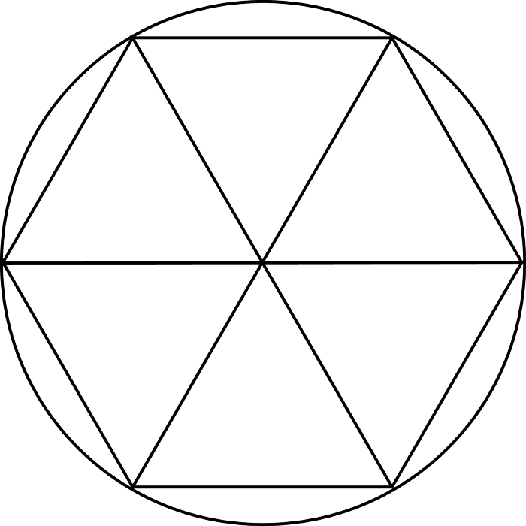
$$r$$
$$r$$

