Slide 1
Integrating Technology: I’ve got an App for that!
James Matte
JMatte@fredonia.edu
Nicole Calbi
NCalbi@fredonia.edu
SUNY Fredonia
AMTNYS
October 28th, 2011

Slide 2
Wolfram Alpha
Introduces a fundamentally new way to get knowledge and answers- not by searching the web, but by doing dynamic computations by using built-in data, algorithms, and methods.

Slide 3
How can Wolfram Alpha be used both in and outside the classroom?
Create visual aids for presentation or lesson plans, including images and graphs.
Shows steps to solving various math problems assigned throughout the curriculum.
For research papers and group projects.
Solves homework problems that teachers assign students in seconds.

Slide 4
I’ve got an App for that:
There are many Apps for the iPad that are beneficial to educators.
After researching the best Apps, three Apps that can be used are:
Wolfram Algebra Course Assistant
Algebra Touch
Math Pro

Slide 5
Wolfram Algebra Course Assistant
Wolfram Algebra Course Assistant is powered by Wolfram Alpha
This app solves specific algebra problems and often shows you how to work through the problem step-by-step.
Wolfram Algebra Course Assistant can be useful with the following topics:
Solving Systems of Equations
Factoring Higher Degree Polynomials
Finding the Inverse of a Function
Dividing any Two Expressions
Expanding any Polynomial
Simplifying Fractions, Square Roots, or Other Expressions
Cost of App: $1.99

Slide 6
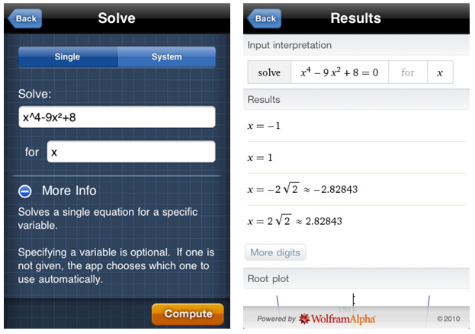
Solve System of Equations
Wolfram Algebra Course Assistant can solve a simple equation or a system of equations for specific variables.
This App will solve a single equation or can solve a system of equations given a variable
The result gives the zeros of the function and thus solving for
The App also plots the roots of a given equation on a graph.

Slide 7
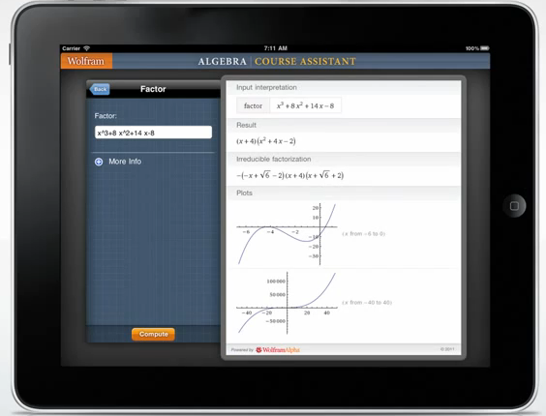
Factoring
This App can factor higher degree polynomials
Example: Factor $x^{3}+8x^{2}+14x−8$
Shows the factors of higher degree polynomials
Also gives different plots given the equation
Shows the irreducible factorization of any polynomial

Slide 8
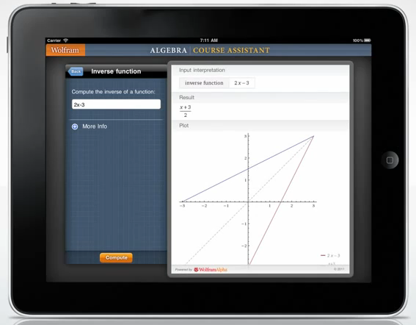
Finding the Inverse of a Function
Given a function, Wolfram Course Assistant can find the inverse of a function.
It also will plot both the original function and the inverse of the function.
Example: $f\left(x\right)=2x−3$
Computes the inverse of the function:
$$f^{−1}\left(x\right)=\frac{x+3}{2}$$
Plots the given function and it’s inverse
On the plot, this App shows the line $y=x$ (dotted) on the graph which will demonstrate to students how the inverse function ($f′(x)$) relates to the original function ($f(x)$)

Slide 9
Compared to Texas Instruments
Solves systems of equations right in the program whereas TI calculators cannot perform in this way.
Gives a better graph of inverse that will help students compare a function and its inverse
Organizes information better and the graphics are far better than that of the TI calculators.

Slide 10
How Can Wolfram Course Assistant Benefit a Mathematics Classroom?
The App can be used as a resource for students to check in class exercises
Aide lessons to help students better understand the material
Save on class time by graphing solutions to help students get a different perspective on a problem
Help emphasize how inverses of a function work from the plot that is given when solving for the inverse

Slide 11
Algebra Touch
Great App for beginners because it teaches you the skills while using the correct techniques
Algebra Touch allows users to able to drag to rearrange, tap to simplify, and draw lines to eliminate identical terms
The App has different level of difficulties
Students can be gain practice of mathematical concepts by using the randomly generated problems or creating their own
Cost of App: $2.99

Slide 12
Order of Operations
Click on the operation that comes first and it will reduce
The App shows if the correct techniques are used because it will not allow students to do the wrong operations.

Slide 13
Compared to Texas Instruments
The calculator can’t tell students if they have the correct answer or if they are performing the correct step
This App shows a great visual or the process of factoring and distributing
This App can teach the techniques hands on rather than just punching things into a calculator

Slide 14
How Can Algebra Touch Benefit a Mathematics Classroom?
Algebra Touch can be used to go over homework problems
Use as a calculator
Teachers can use the random generator to make quiz problems
This App can be projected to show how properties and order of operations work

Slide 15
Math Pro
Explains many of the key concepts that are covered throughout the mathematics curriculum.
This app can be used as a resource for struggling students to help them better understand the more advanced concepts.
The solvers and tutorials add an interactive element for students
This App can serve as a review for students throughout math courses which can include:
Algebra, Geometry, Probability, Statistics, Trigonometry, and even Calculus
Cost of App: $1.99

Slide 16
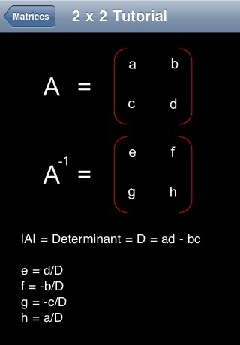
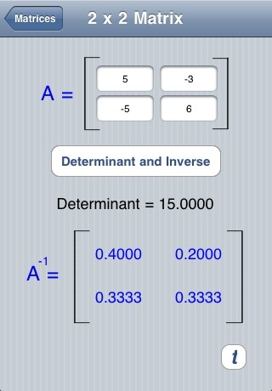
Computing determinant and inverse of 2x2 matrices
Given a 2x2 matrix, Math Pro can compute and show how to compute the determinant of a function
It can also compute the inverse of a matrix

Slide 17
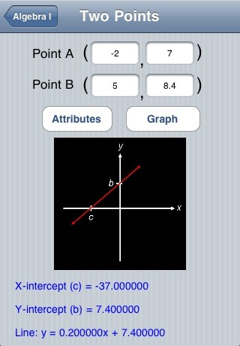
Finding an equation of a line given two points
Given two points on a line, this App gives the equation of the line through those two points.
It also calculates the $X$-intercept and $Y$-intercept

Slide 18
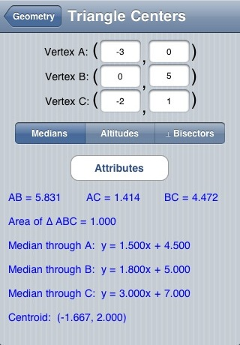
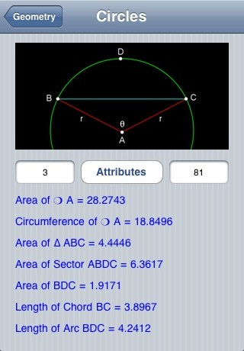
Area of Triangles and Circles
Given three vertices, Math Pro can compute the area of a given triangle and also the lengths of the segments
Math Pro can also compute the area of a circle given its radius.

Slide 19
Compared to Texas Instruments
Plugging in a matrix using Math Pro is much easier than that of a TI calculator which can save classroom time during a lesson.
Finding a line given two points is much easier to do using this app rather than using your calculator to go through all the computation.
Math Pro will calculate the area of triangles and circles where the TI calculators will not.

Slide 20
How Can Math Pro Benefit a Mathematics Classroom?
Teachers can use the tutorials in Math Pro to help explain a concept in the curriculum to students
Math Pro can be used for students who need a little extra help afterschool to help them understand the concepts that are covered in the lessons
This app can be used to make any lesson plan interactive
This App can be used as a review of concepts before a test or exam to help students remember the material

Slide 21
See Demonstrations Online:
Wolfram Alpha Course Assistant
http://www.youtube.com/watch?v=WEWOFUhiXuo
Algebra Touch
http://www.youtube.com/watch?v=A4SdNUwgkcg
Math Pro
Screenshots are available for demonstration
http://www.lfeldman.com/mathpro/screenshots

