Slide 2
Rochester
Batavia
Fredonia
South Dayton

Slide 3
Pizzas, Trains, and Proportional Reasoning AMTNYS, October 28th
By:
Andrew Carucci
and
Kyle Erlandson
SUNY Fredonia

Slide 4
Are Students Really Thinking?
What is 40% of 200?
Whole $×$Percent of Whole $=$ Part of the Whole
200 $×$ .40 $=$ 80
Most 8th grade students can solve this problem
Notes:
How would a student answer this problem?
In typical problems like this, students are usually asked to find the percent of the whole using the formula:

Slide 5
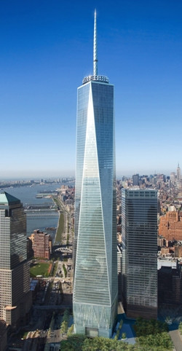
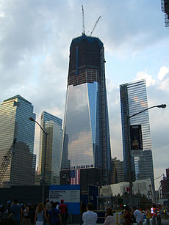
One World Trade Center
Formally known as Freedom Tower
75% of the completed tower
How tall will the tower be when it is completed?
1,026 feet
Notes:
Freedom tower is now under construction. It is expected to be completed by the end of 2012. Right now, the tower stands at 1026ft which is about 75% completed. How tall will the completed tower be?
In this question, we find the height of the tower by dividing 1026 feet by 75% to get the height of the completed tower, 1368 feet. This problem forces students to think differently than traditional linearly proportional problems.

Slide 6
Solution:
How many 8th grade students could solve this problem?
Manipulate the formula:
Whole $×$Percent $=$ Part of the Whole
$\frac{\text{Whole}}{1}$ $= \frac{\text{Part} \text{of} \text{the} \text{Whole}}{\text{Percent}}$
$\text{Whole}\text{ = }\frac{1,026 \text{feet}}{.75}$
One World Trade Center will be 1,368 feet

Slide 7
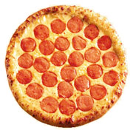
A Pizza Proportional Project
A personal 6-inch pizza costs $3.79
A medium 12-inch pizza costs $10.99
Which is the better buy?
Two 6-inch pizzas for $7.58 or one 12-inch pizza for $10.99?
6in
12 in
Notes:
Suppose you and a friend go to Pizza Hut, but being college students you want to get the most pizza for your money. You suggest getting the medium (12in) pizza which is $10.99. However, your friend notices that you could each get your own personal (6in) pizza for only $7.58. So which is the better buy, two personal pizzas or one medium pizza?

Slide 8
Solution
Which option would most students choose?
Students can visually see that three 6-inch pizzas ($11.37) can fit into one 12-inch pizza ($10.99).
When the diameter of a circle is doubled, the resulting area is quadrupled.
Area of the 6-inch pizza:
$π{(3\text{in})}^{2}$ $=9π {\text{in}}^{2}$
Area of the 12-inch pizza:
$π{(\text{6}\text{in})}^{2}$ $=36π {\text{in}}^{2}$

Slide 9
Alternative Method
Area $=$ ${\text{s}}^{2}$
Area $={(2\text{s}\text{)}}^{2}$
= $4{\text{s}}^{2}$
Notes:
When we double the diameter of the pizza, we are in a sense doubling both the length and the width of the pizza. If we think of a square with an area of 1 inch, when we double the length of its sides, the area of the square is quadrupled. So the medium pizza actually is the better buy, since you would have to buy 4 personal pizzas, which would be more that $15, to get the same area as one medium pizza.

Slide 10
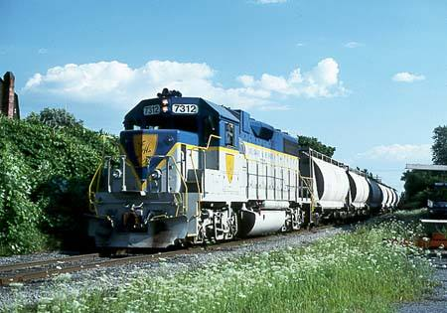
We have a $\frac{1}{87}$ Scale Model of a GP38-2
Notes:
We have a model GP38-2 train that is on a 1/87 scale of the real train. The model weighs ounces. The real GP38-2 weighs 250,000 pounds. If we were to proportionally expand the scale model to have the same measurements of the real train, which train would weigh more: the expanded model, the real train, or would they weigh the same?

Slide 11
The Scale Model Train weighs 14 ounces
The Real-Life GP38-2 weighs 250,000 pounds or 125 tons
Which will proportionally weigh more?
The Scale Model, the Real Train, or would they weigh the same?
Which option would most students choose?
Solution:
$14$ ounces$×{87}^{3}=$9219042 ounces
9219042 ounces $× \frac{1 pound}{16 ounces}$ $=$ 576,190.125 pounds
576,190.125 pounds $×$ $\frac{1 \text{ton}}{2,000 \text{pounds}}$ $≈$ 288 tons
The Scale Model will weigh more than twice as much as the Real Train
Notes:
Since the model train weighs 14 ounces we multiply 14 ounces by 87 three times, since we need to expand the model train’s length, width, and height 87 times for the model train to have the same measurements as the real train. Therefore 14×〖87〗^3=9219042 ounces. Since there are 16 ounces in one pound we divide this number by 16 to find that the model train would weigh 576,190 pounds, which is more than double the weight of the real-life 250,000 pound locomotive.

Slide 12
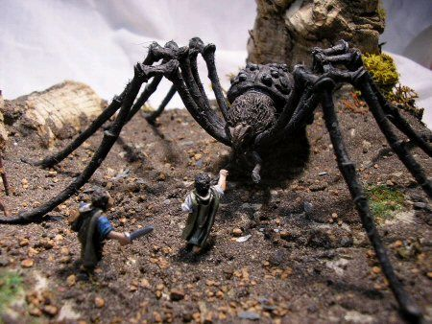
Can giant spiders exist in real life?
Notes:
The answer to this question is easier than you would think. The reason that spiders are the size they are is because the legs of these arachnids are carrying the maximum weight they can support. Combining what we learned in the previous two questions, we can see that a spider’s leg strength is determined by area, so if we were to proportionally expand a spider its legs will only get stronger by a power of 2, while the weight of the spider’s body is determined by volume, so the spider’s weight will increase by a power of 3. Therefore if spiders were proportionally expanded into giant spiders, their legs would not be able to support the weight of their body.

